Slide 1
Gimme S’More
-
Project Overview
Skewer Mechanism
-Automated start to finish S’mores maker that toasts marshmallows and assembles a full s’more.
-Raspberry Pi used for control of motors
-
-3 Degrees of Freedom
-Nema 17 Stepper motors with a Belt and Gear Drive
-Used to skewer the marshmallow for toasting and move it towards the final assembly plate.
-DRV8825 bipolar stepper motor driver
-
Heating Element
Graham Cracker and Chocolate Assembly
-Electric coil used for safety and ease of operation.
-Custom, smaller heating coil obtained from a purchased marshmallow toaster
-Graham cracker and chocolate pushed out of a box by a linear actuator and fall on a central plate
-The plate is then pulled out by a handle and the user pulls out the final assembled s’more.
- Linear actuator pushes out the graham cracker and chocolate from the final

Slide 2


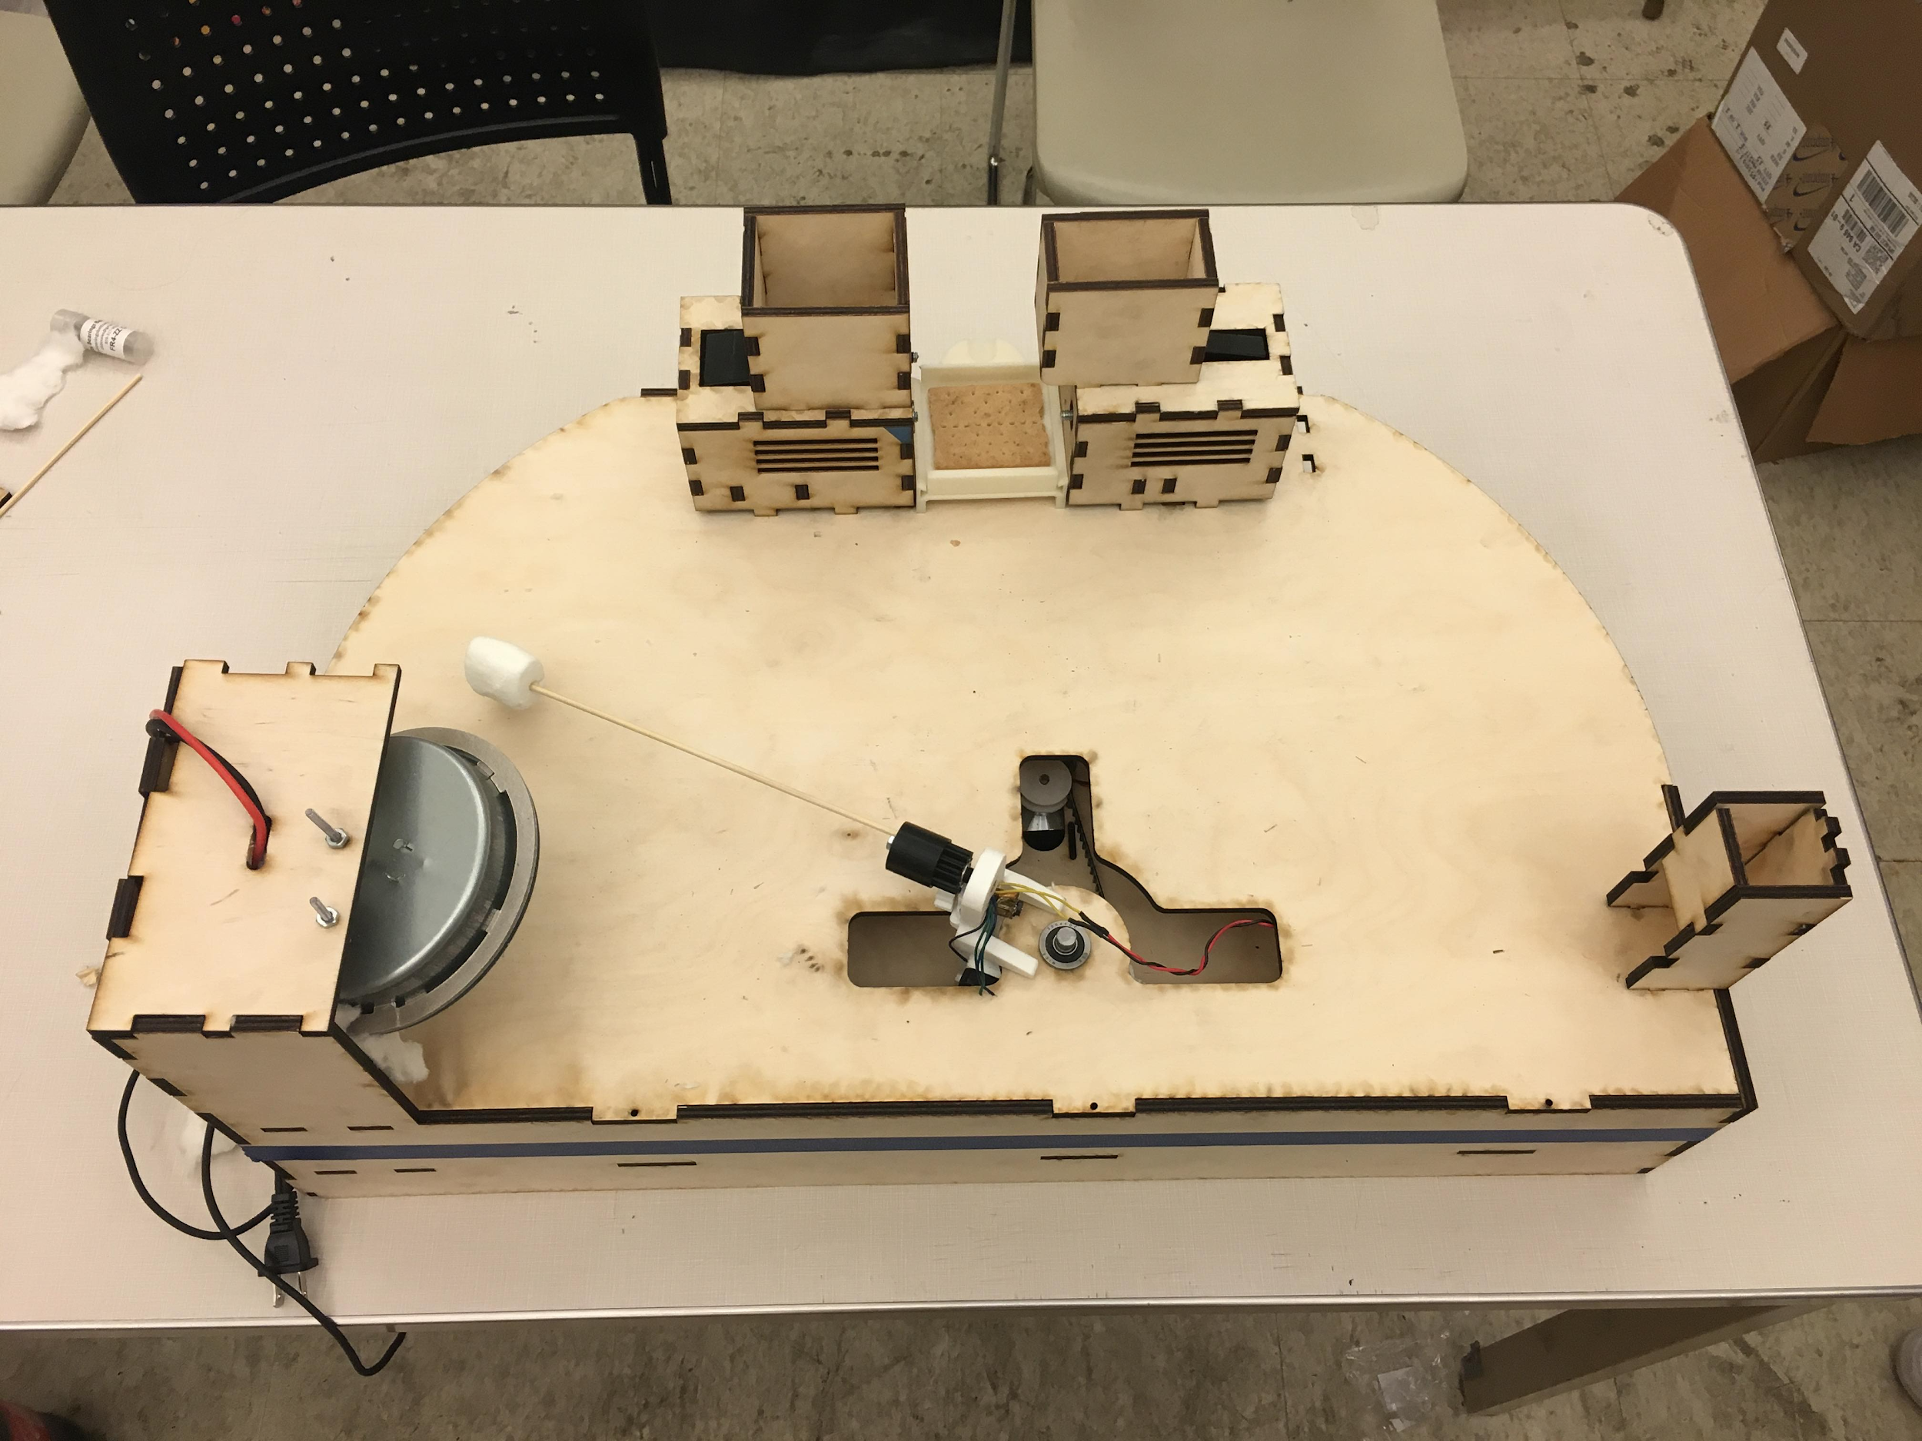
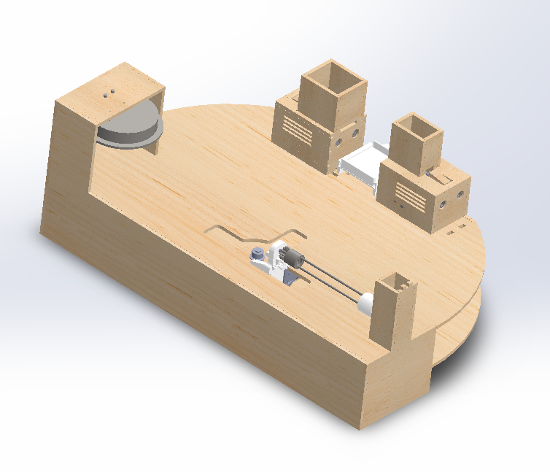
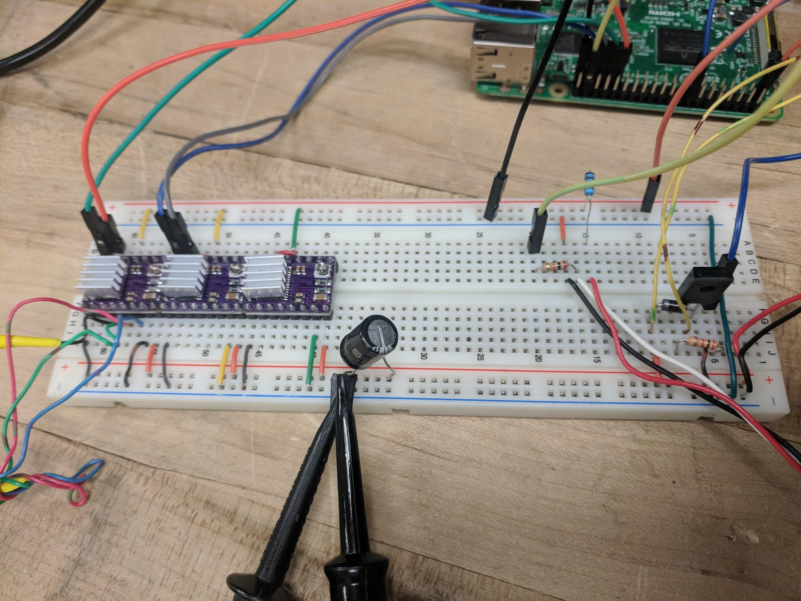
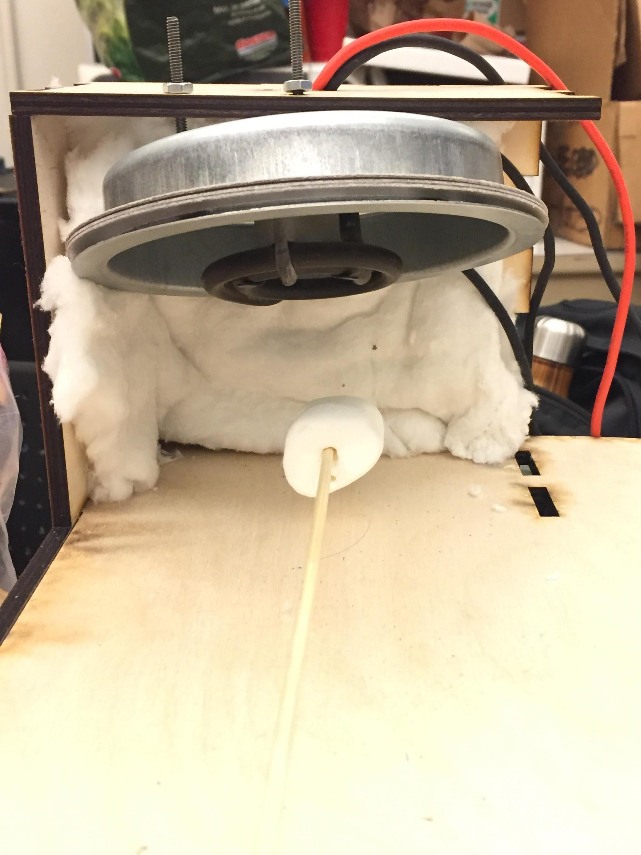
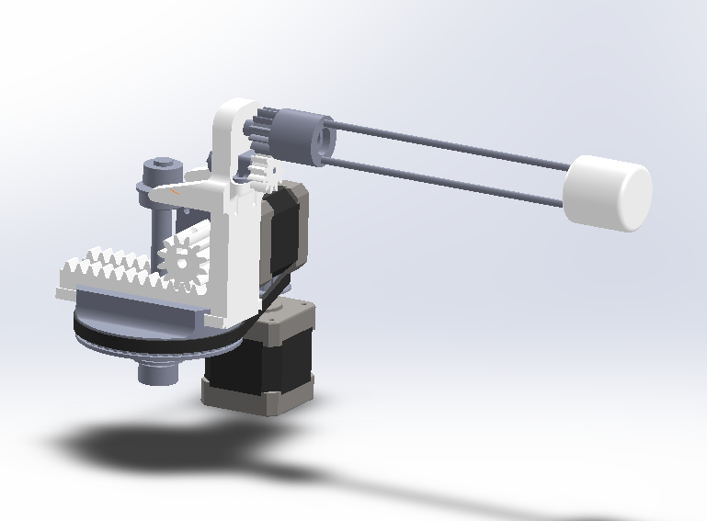
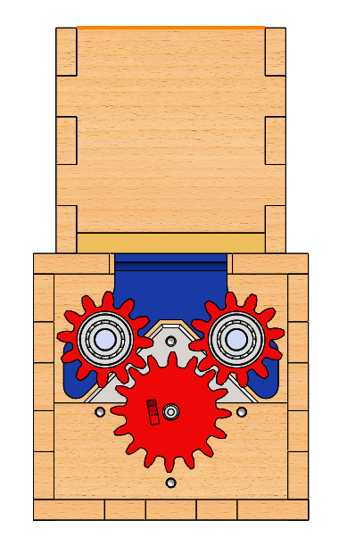
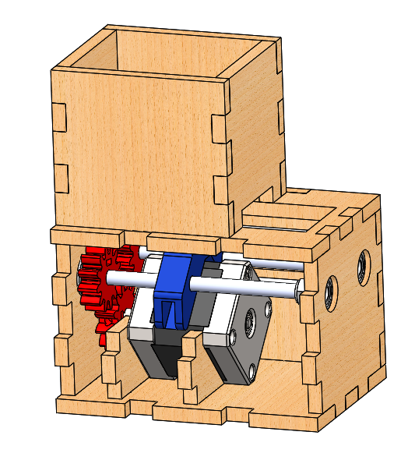
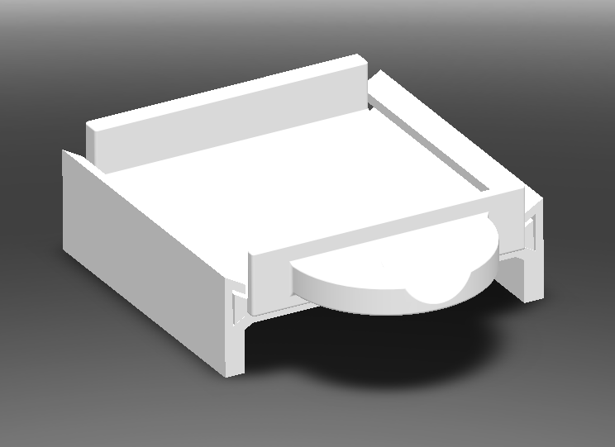
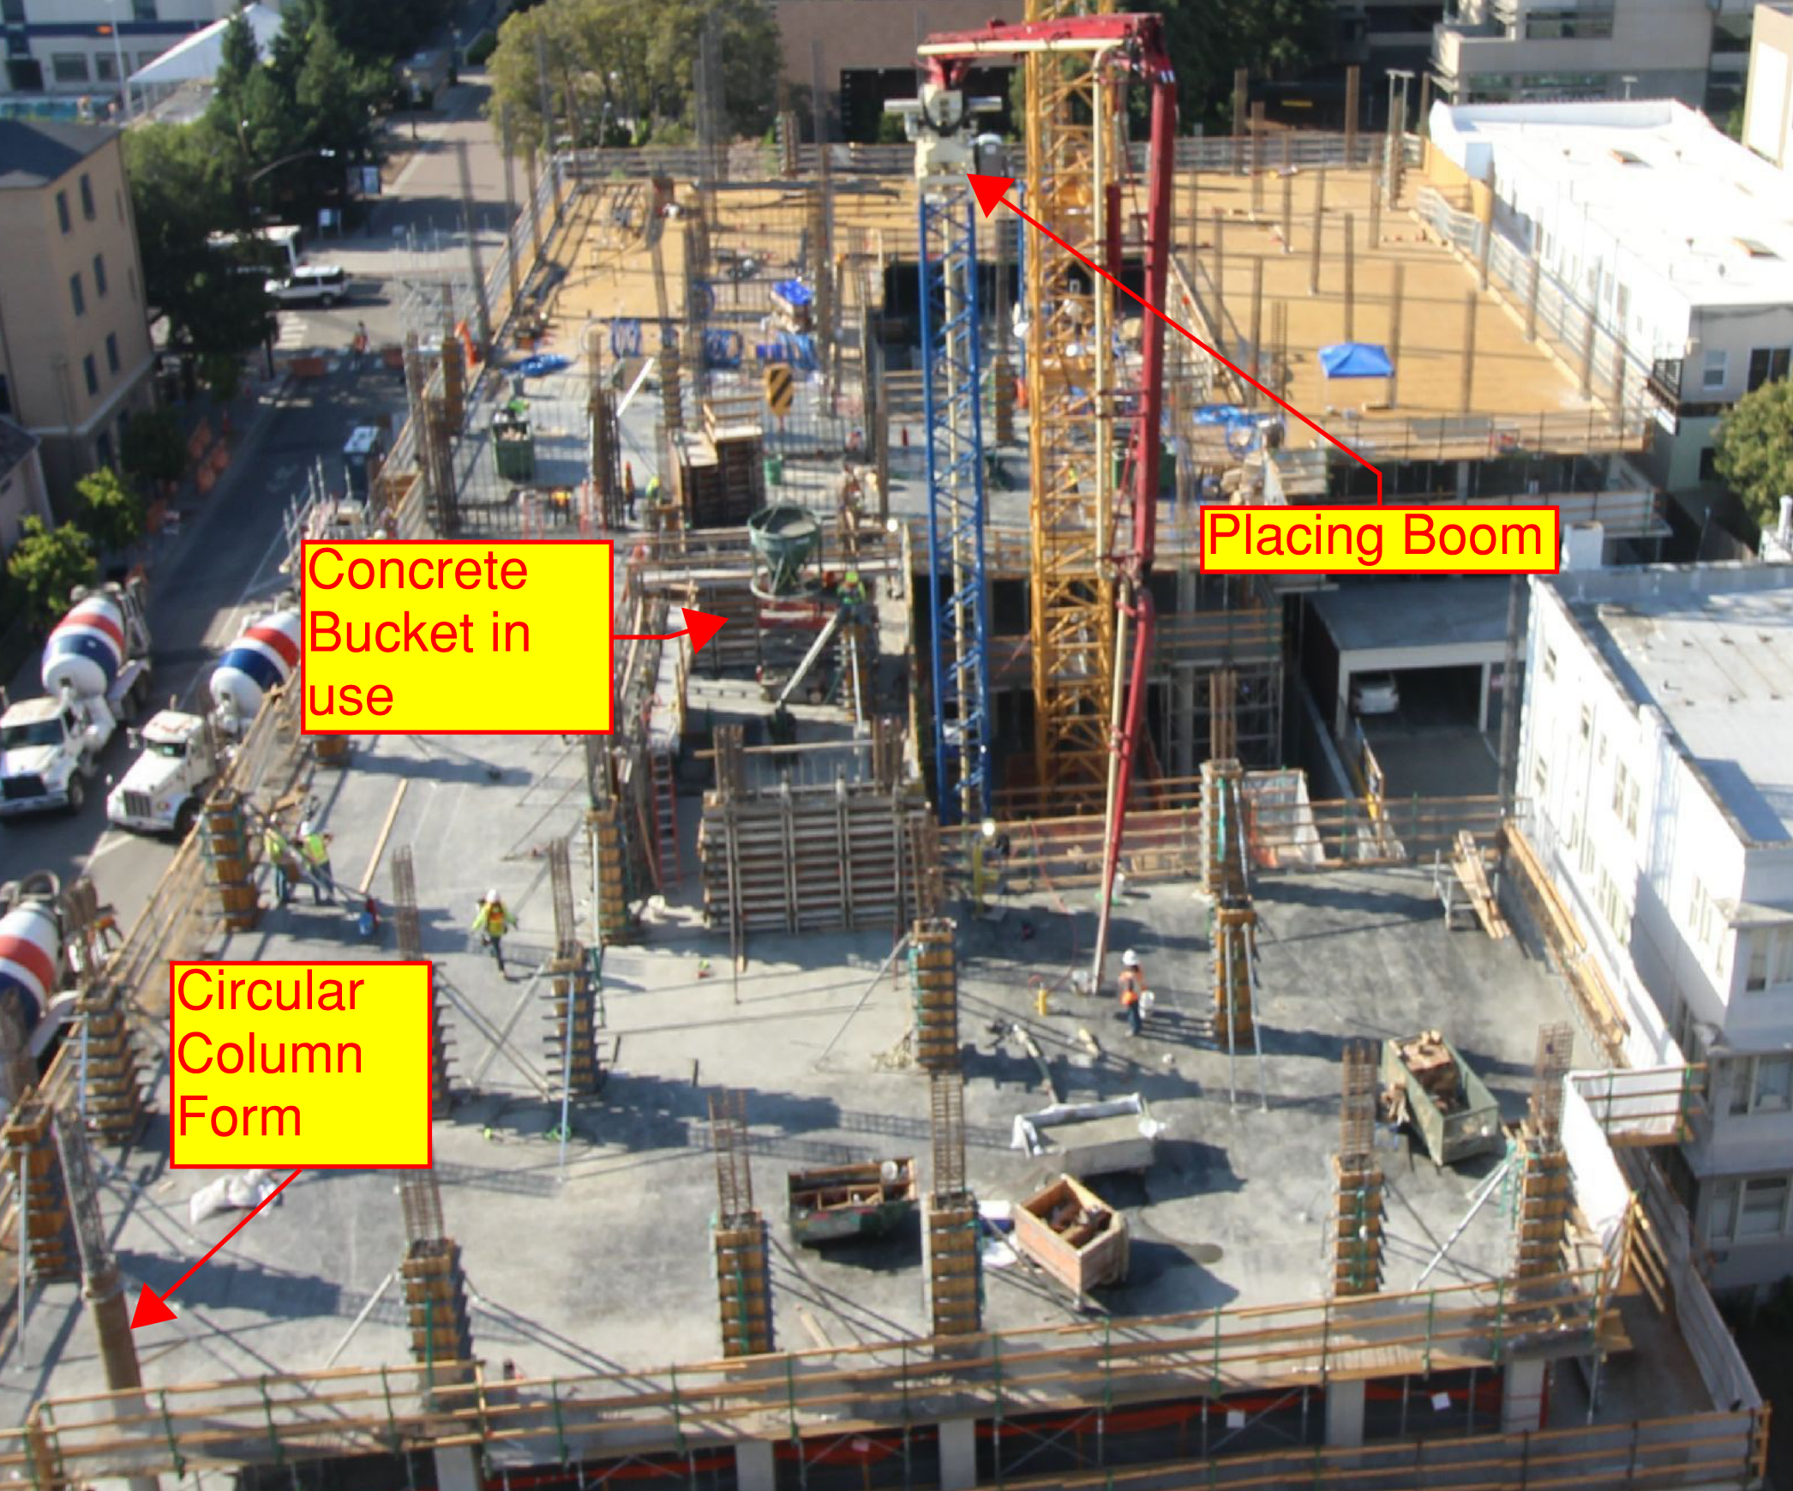
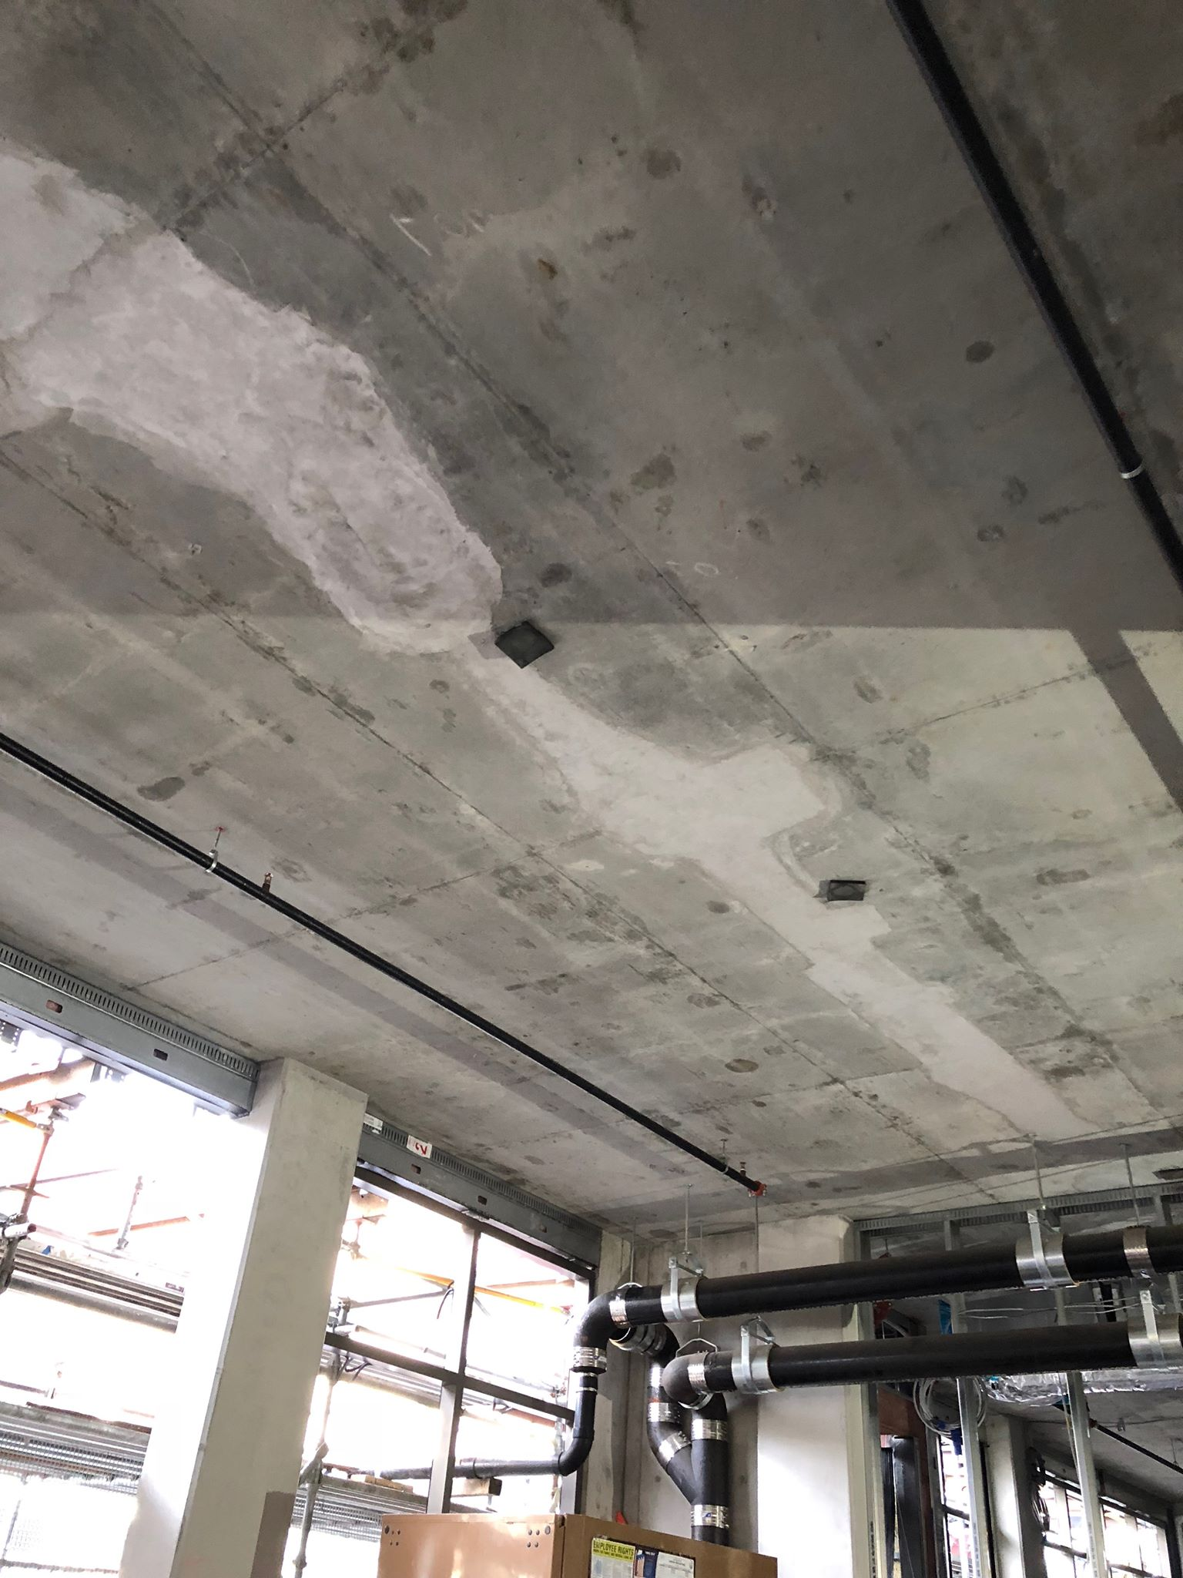
GIMME S’MORE ME 102B Project By Arjun Dave, William Lu, Susanna Pesonen, Nisha Subramanian, Brian Tam, Rachel Thomasson Mechanical Engineering, University of California Berkeley
Project Overview
Our goal was to create an automated s’more assembly machine which requires as little user intervention as possible. The s’more machine is made up of several distinct components which work together through a combination of mechanical and electrical systems to cook and assemble a s’more. The 3D printed and laser cut assembly has five degrees-of-freedom for manipulating the ingredients as well as a heating element for creating the perfectly toasted s’more. Actuation types include belt-drives, gear-drives, lead screws and a rack and pinion.
Full Assembly
IIInsert image of full assembly here
The mechanism is fully automated with the only user input needed being placement of raw ingredients and removal of the s’more. When the user requests a s’more, the machine skewers a marshmallow, moves it to the heating element where it is rotated for an even toast, and then brings it to the assembly station. While the marshmallow is toasting, a single graham cracker and chocolate piece are pushed onto the assembly tray. The top graham cracker is placed on top of the marshmallow after it is moved to the assembly zone.Each component of the assembly is described below in more detail.
Electronics & Control
All electrical components are controlled by a Raspberry Pi
Stepper motors are controlled with DRV8825 motor drivers, and the gear motor is controlled with PWM with a NPN transistor
The heating coil is powered from a wall socket at 120VAC and is controlled via solid state relay with input from a Raspberry Pi's GPIO
Skewer Mechanism
Heating Element
Cracker & Chocolate Assembly
S’More Removal
3 Degrees of Freedom
Nema-17 Stepper motors with belt drive and rack and pinion for linear motion
Used to skewer the marshmallow for toasting and to move it to the final assembly plate.
Pololu micro motor used to rotate marshmallow
Electric coil used rather than a flame for safety and ease of operation
Custom, smaller heating coil obtained from a purchased marshmallow toaster
Software approach for control using solid state relay
Wool used for insulation
A fan cooling agent used to promote forced convection around other heat sensitive components
Compact linear actuator using Nema-17 stepper motors and a lead screw mechanism to push the components into the assembly tray
Graham cracker and chocolate each have their own housing and linear actuator to push them into position on the final assembly plate
3D printed tray made from ABS plastic on which S’more is assembled
Inserts into a rack attached to the full assembly
User pulls out the tray with one thumb placed on the indent of the tray and other hand providing pressure to the top of the assembled s’more
Notes:
The design and manufacture of the s’more machine integrated several engineering techniques such as 3D printing, laser-cutting, rotary and linear motion, rack and pinions, and lead screws.

